Slide 1


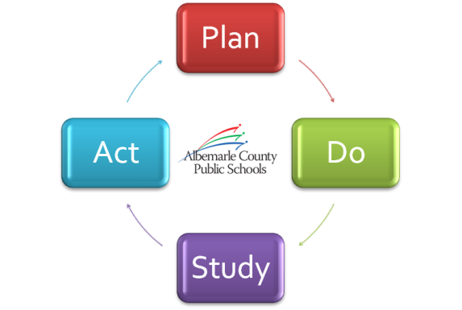



Continuous Improvement in Two Schools
Board Work Session – Part I
September 27, 2012

Slide 2
Agenda
Plan/Do – Walton
Study/Act – Brownsville
Q & A with Schools
20 Minutes
20 Minutes
15 Minutes

Slide 3

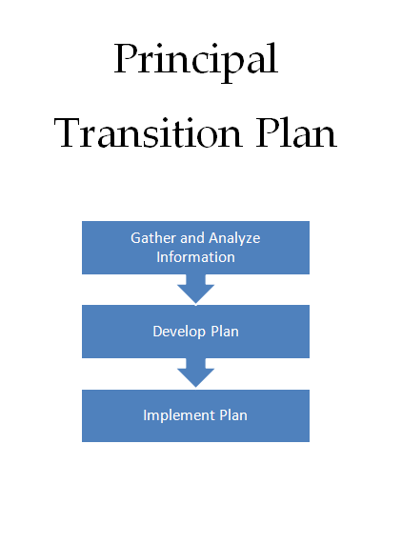
Plan/Do
Walton Middle School

Slide 4

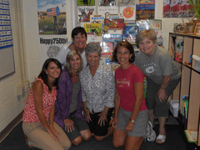
Study/Act
Brownsville Elementary School

Slide 5
Q & A
Continuous Improvement

